Slide 1
ARTIFICIAL INTELLIGENCE & MACHINE LEARNING
Topic:
LOCAL SEARCH ALGORITHM:
HILL CLIMBING
Session – 05 & 06

Slide 2




AIM OF THE SESSION
To familiarize students with the basic concept of Heuristic functions
INSTRUCTIONAL OBJECTIVES
This Session is designed to:
Explain What is Local Search Algorithm?
Describe different types of Local Search Algorithm:Hill Climbing Algorithm, Simulated Annealing
LEARNING OUTCOMES
At the end of this session, you should be able to:
Define the concept of Local Search Algorithm
Understand about types of Local search, Hill Climbing Algorithm, Simulated Annealing

Slide 3
SESSION INTRODUCTION
This session provides the basics of Local Search, Hill Climbing, Simulated Annealing.
This session also gives an idea about types of Optimization

Slide 4
Local Search Algorithm
What Is Local Search In AI?
Local search is a type of Artificial Intelligence (AI) algorithm used to solve optimisation problems. It is also known as simulated annealing or hill-climbing and involves searching for the best solution in a given region using greedy search techniques.
Local search is an algorithm that is used to find the best solution to a problem by starting with a random solution and then making small changes to it until it finds a better solution.
The objective function is at the heart of any local search algorithm; it defines what constitutes an acceptable solution and serves as a measure of how well any given candidate solution fits that definition.
Hill climbing or k opt are examples of local optimisation algorithms that use such functions to identify promising candidates for further refinement until a satisfactory result is obtained.
Search algorithms like quick search can be employed to traverse the search space efficiently, while customer reviews and BBB business profiles provide valuable additional data points for informed decision-making.

Slide 5
Local Search Algorithm…..
The ability for customers to search locally has been made even easier by advances in technology such as voice-activated searches on devices like smartphones and tablets.
This enables customers to quickly find what they are looking for without having to enter extensive search terms into a web browser.
With these advancements, Local Search has become increasingly important for businesses who want to stay competitive in their industry.
Local Search also provides valuable insights about customer behavior that can inform marketing strategies and help brands better understand their target audience.
For companies seeking success, understanding how best to leverage Local Search is essential; it offers significant opportunities but must be approached strategically.

Slide 6
SESSION INTRODUCTION…..
Which Is An Example Of A Local Search?
It requires an understanding of how search engine optimisation (SEO) works, as well as the use of mobile devices and physical locations.
An example of a local search in Australia.
Google Search uses data from its index stores to return results when someone makes a query using a specific expression. Businesses located near where the person making the query is can show up at the top of the search results thanks to this technology.
The technology behind this process is based on K median and facility location problems.
Facility location problems involve finding good positions for facilities so they are able to serve most people in the area efficiently with minimal cost.
In order to find optimal solutions for these types of problems, Google’s algorithms need detailed information about Australian businesses, such as business type, geographical coordinates, customer reviews, opening hours and more.
With accurate data available, Google can then rank businesses according to relevance and proximity to users' current location.

Slide 7
Local Search Algorithm
Local Search Algorithms
Several local search algorithms are commonly used in AI and optimization problems. Let's explore a few of them:
Let's delve into some of the commonly used local search algorithms:
1. Hill Climbing
2. Local Beam Search
3. Simulated Annealing

Slide 8
HILL CLIMBING
Artificial intelligence (AI) uses the straightforward optimization method known as "hill climbing" to identify the optimum answer to a given issue.
We learn the following two strategies as part of Informed Search Strategies.
Simple Hill climbing:
Steepest Ascent Hill climbing
Stochastic hill climbing

Slide 9
Types of HILL CLIMBING
1. Simple Hill climbing:
It looks at each neighboring node individually and chooses the first one that minimizes the current cost as the next node.
Steepest Ascent Hill climbing:
It initially looks at all the nearby nodes before choosing the one that is most near the solution state as the next node.
Stochastic hill climbing:
It chooses a node without first considering all of its neighbors. It just chooses a neighboring node at random and determines whether to go there or to look at another based on how much that neighbor has improved.

Slide 10
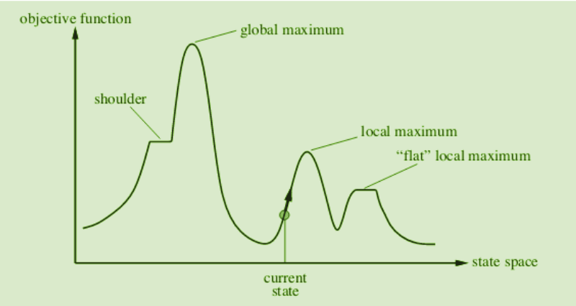
STATE SPACE DIAGRAM FOR HILL CLIMBING:
The state-space diagram plots our search algorithm's collection of possible states against the value of our objective function, or the function we want to maximize.
X-axis: denotes the state space i.e. states or configuration our algorithm may reach.
Y-axis: denotes the values of objective function corresponding to a particular state.

Slide 11
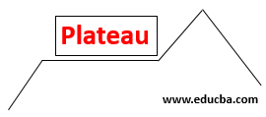
DIFFERENT REGIONS IN THE STATE SPACE DIAGRAM:
Local maximum: A state exists that is better than it (the global maximum), but it is not better than its neighbour. This state is preferable because the goal function's value is higher here than it is in its surrounding states.
Global maximum: In the state space diagram, it is the ideal state that is conceivable. This is due to the goal function having the maximum value at this point.
Plateau/flat local maximum: It is a flat area in state space where states close by have equal values.

Slide 12
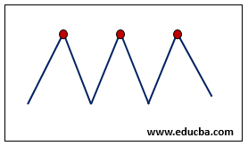
Ridge: It is a location that is higher than its surroundings yet has a slope of its own. This particular local maximum is unique.
Current state: The region of the state space diagram where we are currently present during the search.
Shoulder: It is a plateau with an upward-facing edge.
Hill Climbing Algorithm is a very widely used algorithm for Optimization related problems as it gives decent solutions to computationally challenging problems.
It has certain drawbacks associated with it like its Local Minima, Ridge, and Plateau problem which can be solved by using some advanced algorithm.

Slide 13
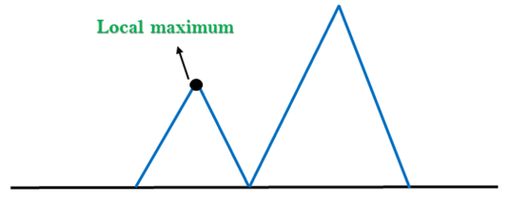
PROBLEMS IN HILL CLIMBING:
1. Local Maximum: A local maximum is a state that dominates its surrounding states but is surpassed by another state that is also present and is higher than the local maximum.
Solution: In the state space landscape, the local maximum can be resolved using the backtracking approach. Make a list of the promising paths so that the algorithm may go back and investigate other routes.

Slide 14
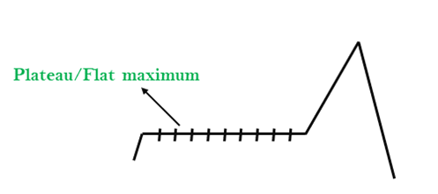
Plateau: A plateau is a flat region of the search space where all neighbour states of the current state have the same value. As a result, the algorithm is unable to determine the optimum course of action. In the plateau region, a hill-climbing search may become disoriented.
Solution: Making either large or little movements while looking for a solution can help you get over the plateau. Choose a state at random that is remote from the one you are in now, giving the algorithm a chance to discover a non-plateau region.

Slide 15
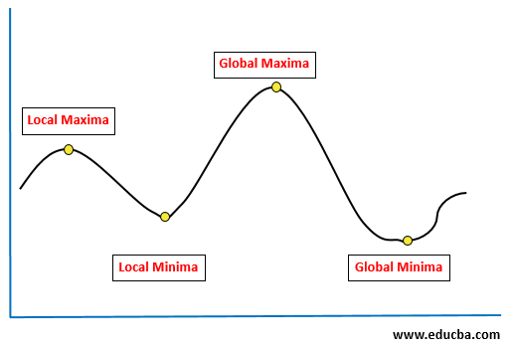
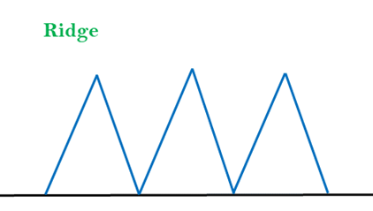
Ridges: The local maximum might take distinctive forms, such as ridges. It has a portion that is higher than the places around it, but because of its own slope, it cannot be reached in a single motion.
Solution: We can make this situation better by using bidirectional search or by going in separate ways.

Slide 16
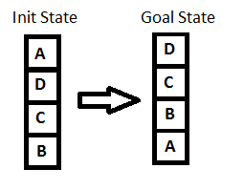
BLOCK WORLD PROBLEM
The most important step in solving any hill-climbing issue is to pick the right heuristic function.
Definition of such a function, h
If the block is appropriately positioned, h(x) = +1 for all the blocks in the support structure; otherwise, h(x) = -1 for all the blocks in the support structure.

Slide 17
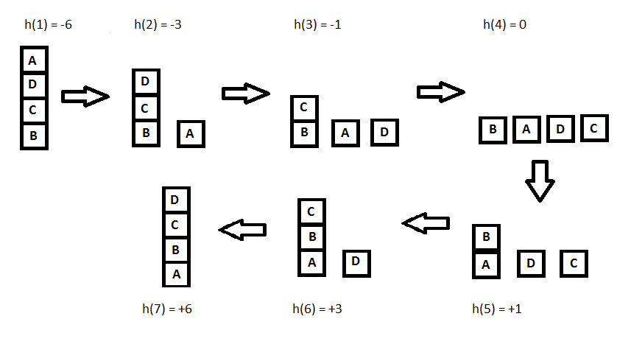
Any block that has the same support structure as the objective state is referred to in this context as being appropriately positioned. Let's have a look at all the iterations and their heuristics to achieve the goal state using the hill climbing approach we outlined earlier:

Slide 18
Steepest-Ascent Hill Climbing
This is a variation of simple hill climbing which considers all the moves from the current state and selects the best one as the next state. Also known as Gradient search
Algorithm: Steepest-Ascent Hill Climbing
Evaluate the initial state. If it is also a goal state, then return it and quit. Otherwise, continue with the initial state as the current state.
Loop until a solution is found or until a complete iteration produces no change to current state:
Let SUCC be a state such that any possible successor of the current state will be better than SUCC
For each operator that applies to the current state do:
Apply the operator and generate a new state
Evaluate the new state. If is is a goal state, then return it and quit. If not, compare it to SUCC. If it is better, then set SUCC to this state. If it is not better, leave SUCC alone.
If the SUCC is better than the current state, then set current state to SUCC.

Slide 19
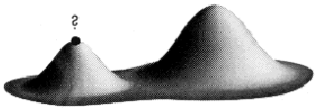
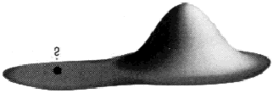
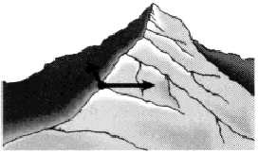
Hill-climbing (continued…) - Limitations
Both simple Hill climbing and Steepest-Ascent Hill climbing may have following limitations:
Local Maxima: a local maximum as opposed to global maximum.
Way Out: Backtrack to some earlier node and try going in a different direction
2. Plateaus: An area of the search space where evaluation function is flat, thus requiring random walk.
Way out: Make a big jump to try to get in a new section
3. Ridge: Where there are steep slopes and the search direction is not towards the top but towards the side.
Way out: Apply two or more rules before doing the test.

Slide 20
Simulated Annealing
Simulated Annealing
Simulated Annealing is a heuristic search algorithm applied to optimization and artificial intelligence issues. By allowing the algorithm to occasionally accept moves that do not improve, this variation of the hill climbing algorithm can avoid the issue of getting stuck in local optima.

Slide 21
steps of the simulated annealing algorithm
Start with an initial solution.
Set the initial temperature to a high value.
Repeat the following steps until the stopping criterion is met:
Generate a new solution by making a small modification to the current solution.
Evaluate the objective function of the new solution.
If the new solution improves the objective function, accept it as the new current solution.
If the new solution does not improve the objective function, accept it with a probability that depends on the difference between the objective function values of the current and new solutions and the current temperature.
Decrease the temperature according to a cooling schedule.

Slide 22
Return the current solution as the final solution.
The main principle of the simulated annealing algorithm is to control the level of randomness in the search process by altering the temperature parameter. High temperatures enable the algorithm to explore new regions of the search space by increasing its propensity to accept non-improving moves. The algorithm becomes more selective and concentrates on improving the solution as the temperature drops.
Simulated annealing has been successfully applied to a wide range of optimization problems, such as the traveling salesman problem, the vehicle routing problem, and the job shop scheduling problem. However, it requires careful tuning of the temperature and cooling schedule parameters to achieve good performance.

Slide 23
Travelling Salesman Problem
The Traveling Salesman Problem (TSP) is a well-known example of a combinatorial optimization problem in which the goal is to determine the quickest path between the starting city and a given set of cities. No known algorithm can complete it in polynomial time because it is an NP-hard problem.
Local search algorithms for the TSP work by starting with an initial solution and incrementally improving it by making small changes to it one at a time until no more advancements are possible.

Slide 24
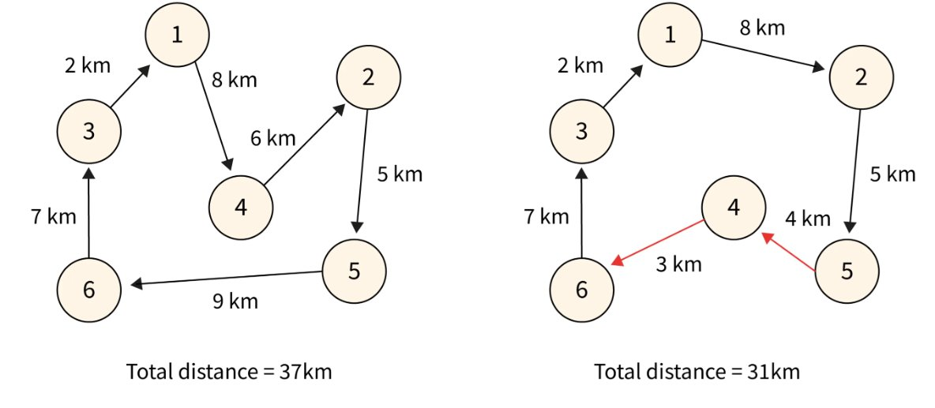
Travelling Salesman Problem

Slide 25
summary
Local search algorithms iteratively improve a single solution by making small modifications to it.
.Local search algorithms are often simple and efficient and can handle large solution spaces.
However, they are prone to get stuck in local optima, where the solution is not the global optimum.
To overcome this limitation, various modifications to local search algorithms have been proposed, such as tabu search, simulated annealing, and genetic algorithms.

Slide 26
SELF ASSESSMENT QUESTIONS
Local search algorithms can solve?
Any problems
optimization problems
Algorithm
Hill climbing is sometimes called.?
Local maxima
greedy local search
optimal solution

Slide 27
TERMINAL QUESTIONS
Define Hill Climbing Algorithm with suitable example.
Write the problems in Hill Climbing Algorithm
Define Ridges and plateau
List the different Regions of Hill Climbing Algorithm.
Write an algorithm of hill climbing heuristic search technique

Slide 28
Reference Books:
1. Russel and Norvig, ‘Artificial Intelligence’, third edition, Pearson Education, PHI, (2015)
2. Elaine Rich & Kevin Knight, ‘Artificial Intelligence’, 3nd Edition, Tata Mc Graw Hill Edition, Reprint( 2008)
Sites and Web links:
https://www.virtusa.com/digital-themes/heuristic-search-techniques
https://towardsdatascience.com/a-star-a-search-algorithm-eb495fb156bb
https://www.tutorialandexample.com/local-search-algorithms-and-optimization-problem/
http://cgi.di.uoa.gr/~ys02/siteAI2008/local-search-2spp.pdf
http://aima.eecs.berkeley.edu/slides-pdf/chapter04b.pdf

